Slide 1
Competencias previas
Programación Orientada a Objetos
Ing. Arturo Hinojosa Ramírez

Slide 2


Aplica algoritmos y lenguajes de programación
para diseñar e implementar soluciones a
problemáticas del entorno.

Slide 3
Diseño Algorítmico
Pseudocódigo
Diagramas de flujo
Introducción a la Programación
Conceptos básicos.
Control de Flujo
Estructuras selectivas: simple, doble y
Características del lenguaje de programación.
Estructura básica de un programa.
Elementos del lenguaje: tipos de datos, literales, constantes, variables, identificadores parámetros, operadores y salida de datos.
múltiple.
Estructuras iterativas: repetir mientras, hasta, desde.

Slide 4
Organización de datos
Arreglos
Modularidad
Unidimensionales
Multidimensionales
Funciones

Slide 5


Slide 6
One hot summer day Pete and his friend Billy decided to buy a watermelon. They chose the biggest and the ripest one, in their opinion. After that the watermelon was weighed, and the scales showed w kilos. They rushed home, dying of thirst, and decided to divide the berry, however they faced a hard problem.
Pete and Billy are great fans of even numbers, that's why they want to divide the watermelon in such a way that each of the two parts weighs even number of kilos, at the same time it is not obligatory that the parts are equal. The boys are extremely tired and want to start their meal as soon as possible, that's why you should help them and find out, if they can divide the watermelon in the way they want. For sure, each of them should get a part of positive weight.

Slide 7

Input
The first (and the only) input line contains integer number w (1 ≤ w ≤ 100) — the weight of the watermelon bought by the boys.
Output
Print YES, if the boys can divide the watermelon into two parts, each of them weighing even number of kilos; and NO in the opposite case
Input
8
Output
YES
Note
For example, the boys can divide the watermelon into two parts of 2 and 6 kilos respectively (another variant — two parts of 4 and 4 kilos)

Slide 8
start
r , w integer
w
r = w % 2
r = 0
True
YES
end
False
NO

Slide 9
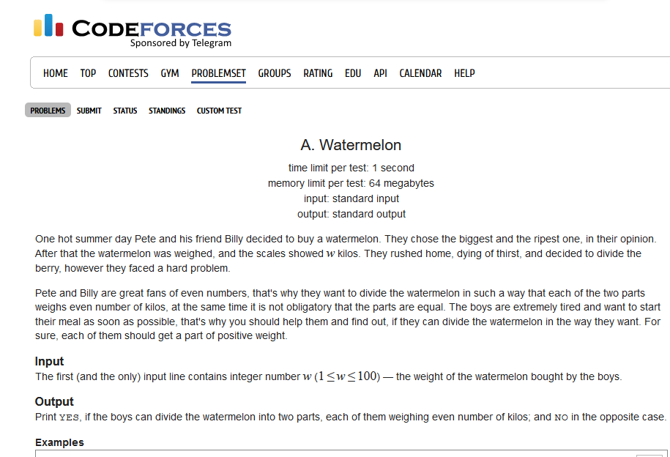
http://codeforces.com/problemset/problem/4/a

Slide 10
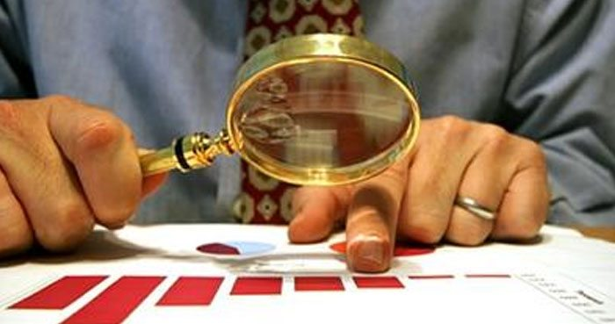
w = 2
bill = 1
pete = 1
r = 2 % 2 = 0

Slide 11
start
r , w integer
w = 2
w
True
NO
r = w % 2
False
YES
r = 0
True
False
end
NO

Slide 12
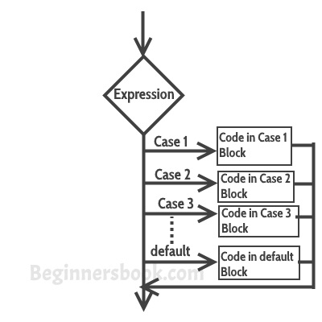
Switch Case statement
Switch case statement is used when we have number of options (or choices) and we may need to perform a different task for each choice.

Slide 13
switch (variable or an integer expression)
{
case constant:
//Java code
;
case constant:
//Java code
;
default:
//Java code
;
}

Slide 14
Break statement in Switch Case
Break statements are used when you want your program-flow to come out of the switch body. Whenever a break statement is encountered in the switch body, the execution flow would directly come out of the switch, ignoring rest of the cases

Slide 15
int i=2;
switch(i)
{
case 1:
System.out.println("Case1 ");
break;
case 2:
System.out.println("Case2 ");
break;
case 3:
System.out.println("Case3 ");
break;
case 4:
System.out.println("Case4 ");
break;
default:
System.out.println("Default ");
}

Slide 16
Scanner scanner=new Scanner(System.in);
System.out.println("Enter a character : ");
char ch=scanner.next().charAt(0);
switch(ch)
{
case 'a' :
case 'e' :
case 'i' :
case 'o' :
case 'u’ : System.out.println(“Vocales”);
}

Slide 17
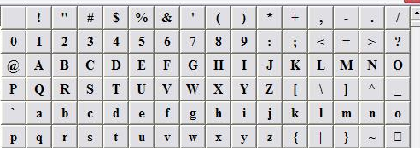
vowels consonants symbols
Given a character identify if it is a vowel, consonant, number or another symbol

Slide 18
Input
Output
A
9
F
$
a
vowels
number
consonants
Symbols
vowels

Slide 19
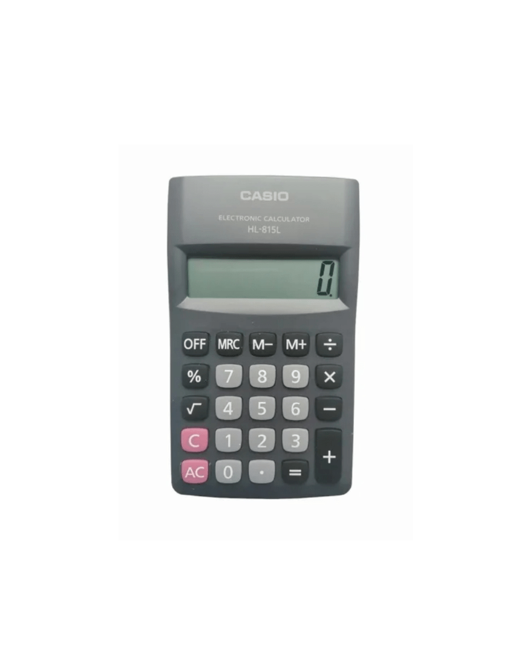
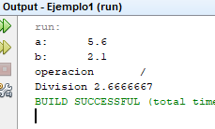
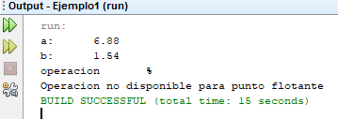
Allows the input of floating values ​​to your calculator, consider that the module is only for integer values

Slide 20
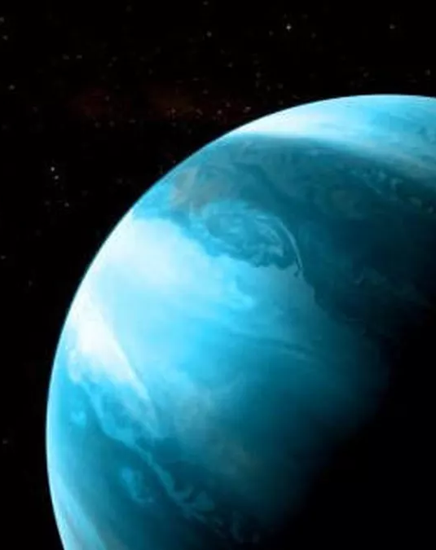
Strange Planet
On a very strange planet, minutes are 50 seconds, hours are 70 minutes, and days are 12 hours. Since you plan to go on vacation to that planet, you would like to have a clock that, given a number of seconds, displays the number of days, hours, minutes and seconds of that planet.
For example, for s = 3553 0 days, 1 hour, 1 minute, and 3 seconds have elapsed. Write a program for your watch to work properly.

Slide 21
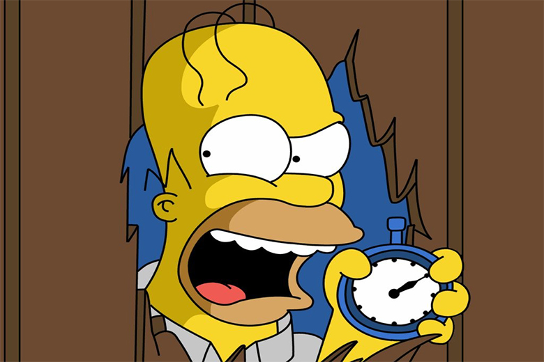
Input s integer
s = 3553
0 days,
1 hour,
1 minute,
3 seconds

Slide 22
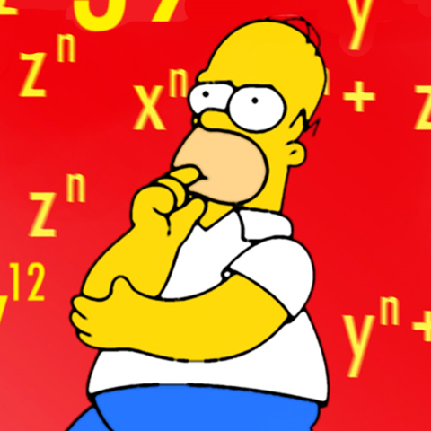
Input s integer
s = 3553
m = 3553 / 50
m = 71.06
s = 3553 % 50
s = 3
h = 71 / 70
h = 1
m = 71 % 70
m = 1
1 m = 50 s
1 h = 70 m
1 d = 12 h
d = 1 / 12
d = 0
h = 1 % 12
h = 1
0 days,
1 hour,
1 minute,
3 seconds

Slide 23
start
d = h / 12
Seg, d,h,m,s integer
h = h%12
seg
d,h,m,s
m = seg / 50
end
s = seg % 50
h = m / 70
m = m % 70

Slide 24
Leap year
Program that reads a year on the keyboard and checks if it is leap.
A year is leap if it meets the following: it is divisible by 4 and it is not by 100 or if it is divisible by 400.

Slide 25

Input
1000
1004
1005
1200
Output
28
29
28
29

Slide 26
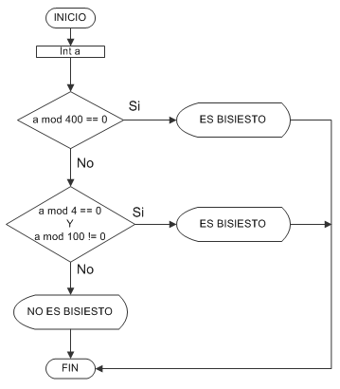
29
29
28

Slide 27


Slide 28
Minors Adults
Input
1999
2004
1969
1950
2002
Output
Mayor de edad
Menor de edad
Mayor de edad
Mayor de edad
Mayor de edad

Slide 29
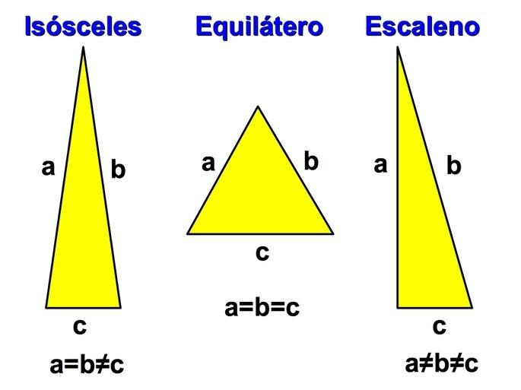
Tipos de Triángulos
Mostrar que tipo de triángulo es el que se generaría con 3 datos x, y, z .
Equilátero: triángulo con los 3 lados iguales.
Isósceles: triángulo con 2 lados iguales.
Escaleno: triángulo con los 3 lados desiguales.

Slide 30
Entrada Salida
4 5 5 isosceles
7 5 2 escaleno
3 3 3 equilatero

Slide 31
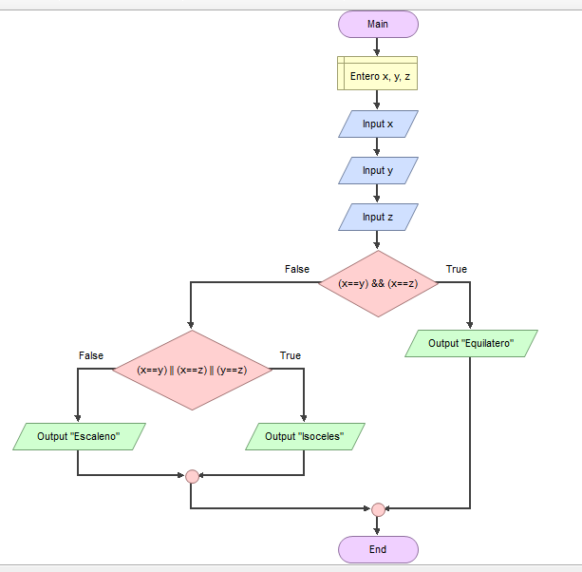

Slide 32
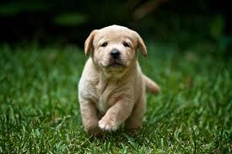
Don Pancho's dog has just given birth to “c” puppies. Since Don Pancho is very fond of dogs, he plans to keep at least “p” of them and the others will try to distribute them equally among the rest of his family, which includes his wife as well as his children “h”. The puppies that he cannot distribute equally among them, he will also keep. How many puppies will Don Pancho keep?

Slide 33
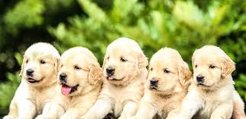
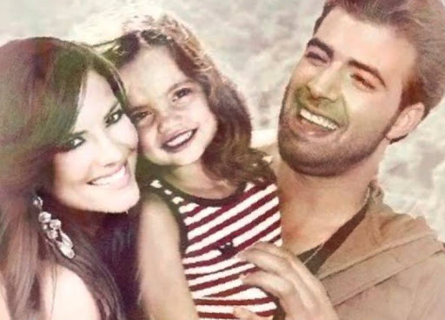
Input
c p h
5 2 1
Output
An integer that is the number of puppies that Don Pancho will keep
3

Slide 34
Cachorros de don pancho
The total number of puppies "c" minus those that don pancho "p" remains.
5 – 2 = 3
Those who remain are divided among the children "h" + 1 (the wife)
3 / 2 = 1.5
Puppies cannot be split. So those who remain stay with Don Pancho.
P = 2 + 1

Slide 35

start
c, p, h,pi
pi = (c – p) % (h + 1)
p = p + pi
p
end

Slide 36
robatamales gang
The robatamales gang has struck a new blow and they are about to share the delicious loot. The leader of the band will keep half of the tamales (if the total is odd, they will also keep the leftover tamale) and the others will be distributed equally among the rest of the band.
Tamales that cannot be distributed equally without breaking them will also be kept by their leader. How many tamales will the leader of the band eat?

Slide 37
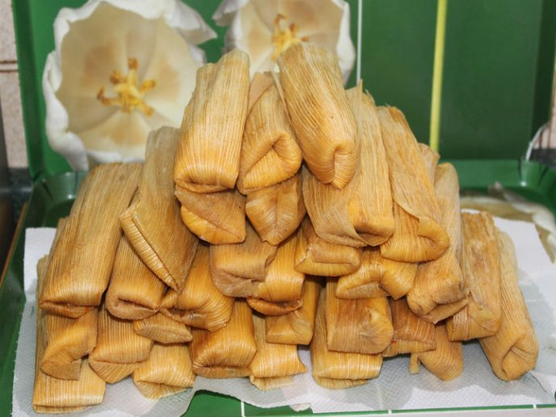
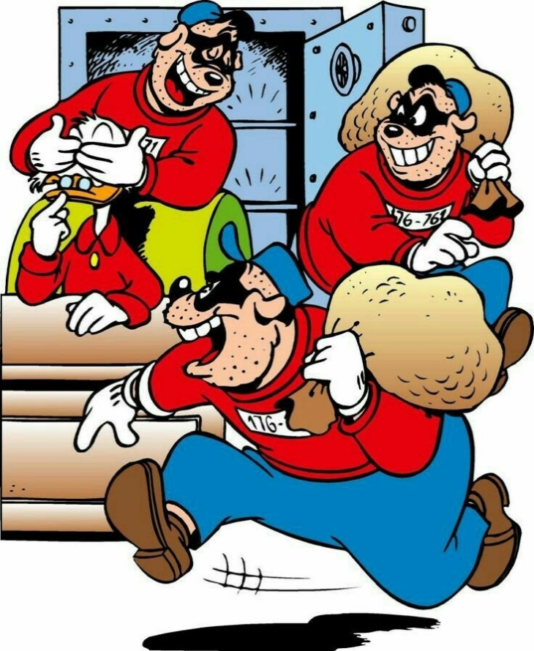

Slide 38
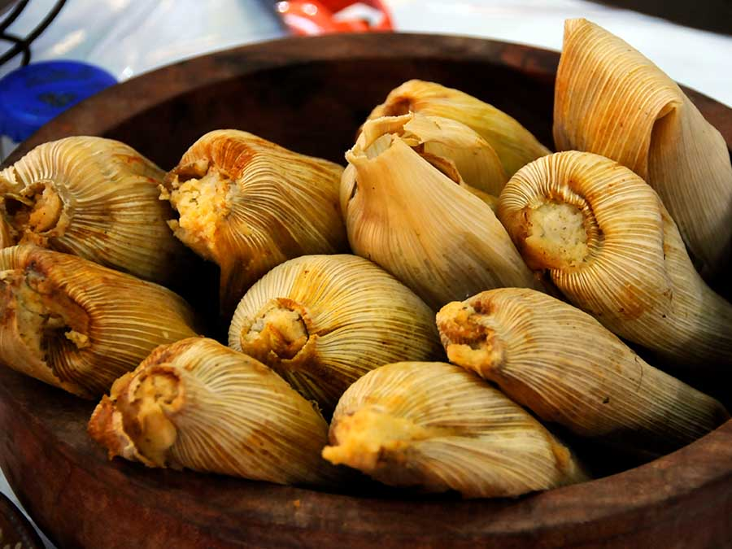
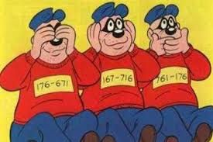
Input
T = 11
B = 3

Slide 39
output
The leader initially keeps 6 tamales and the rest will be distributed among the rest of the band. The equitable distribution of 5 tamales among the two remaining members results in 2 tamales per person and one left over, which is also kept by the leader.
Total = 11
half = 5
Leader = 5 + 1
Left = 5
Band = 2
Leader = 6 + 1 = 7
Leader eat: 7

Slide 40
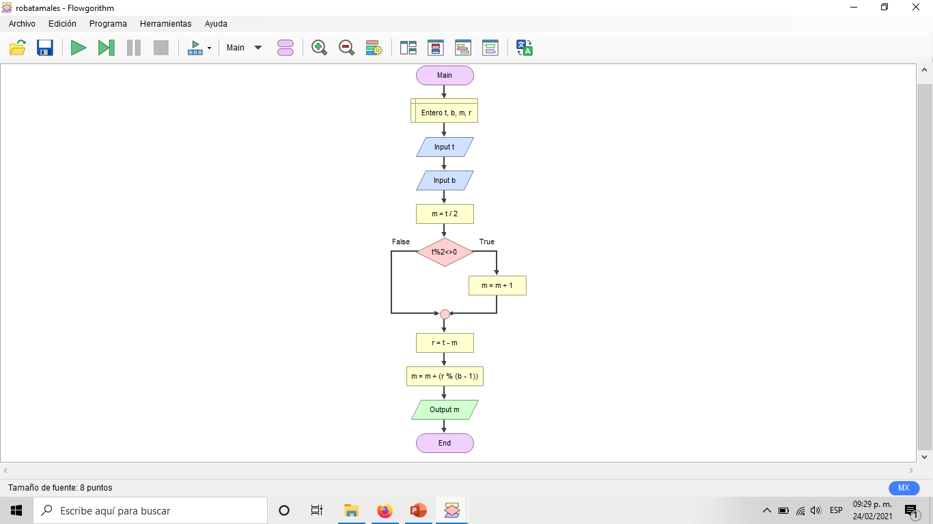

Slide 41
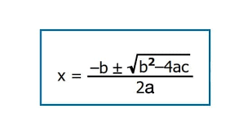
Programa que calcule la solución de una
Ecuación de segundo grado por la formula general dados los Coeficientes a, b, c

Slide 42
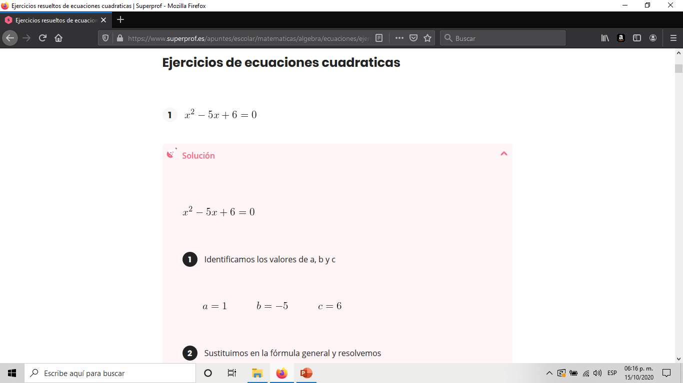

Slide 43
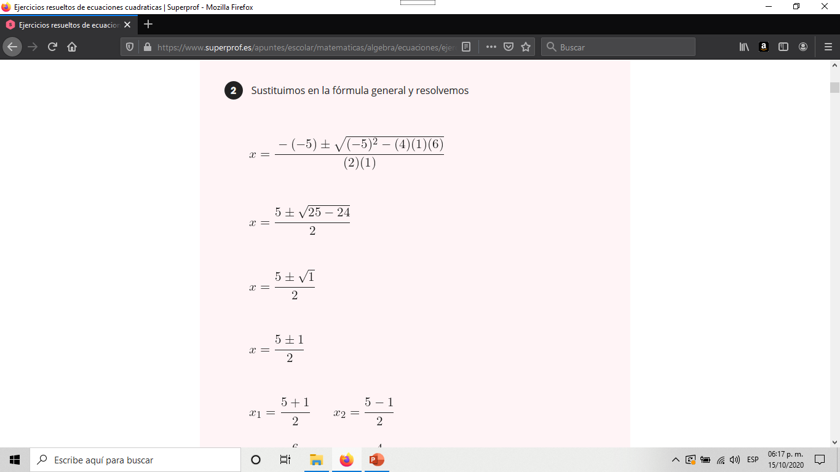
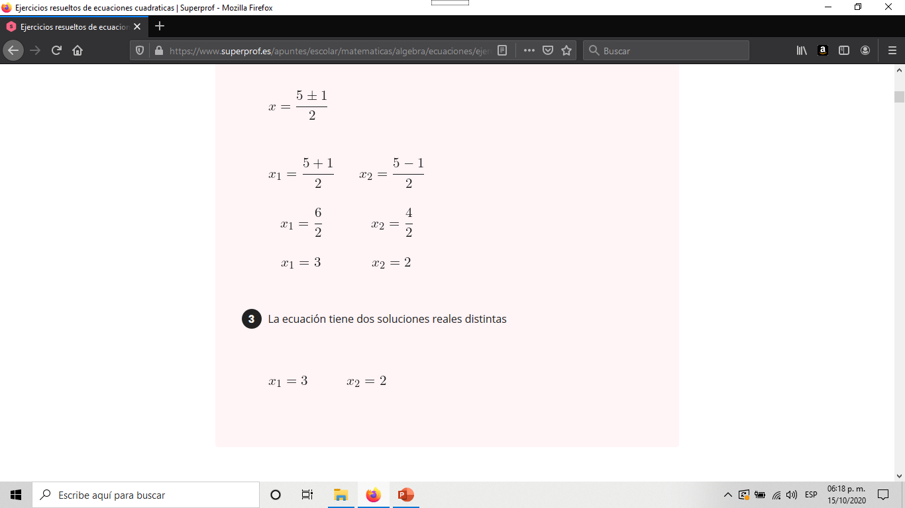

Slide 44
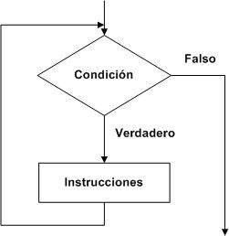
Ciclo while

Slide 45
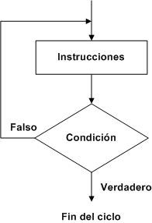
Ciclo do while

Slide 46
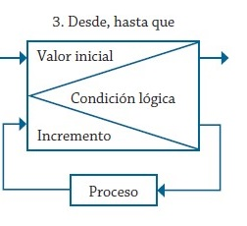
Ciclo for

Slide 47
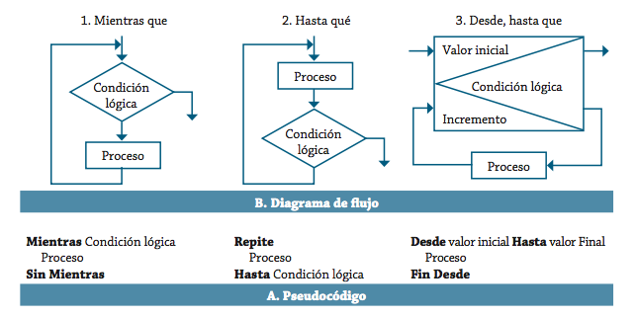

Slide 48
En matemáticas y estadística, la media aritmética, también llamada promedio o media, de un conjunto infinito de números es el valor característico de una serie de datos cuantitativos, objeto de estudio que parte del principio de la esperanza matemática o valor esperado, se obtiene a partir de la suma de todos sus valores dividida entre el número de sumandos. Calcule el promedio de la lista de elementos .
Entrada
Un número entero “n” seguido de la lista de elementos “l” . “l” será una lista de números enteros menores a 1000 separados por espacio. 0< l <1000

Slide 49
Salida
Promedio de “l”
Ejemplo:
Input
6
1 4 5 9 11 3
Salida
5.5

Slide 50
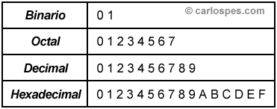
Numero decimal: 240
Hexadecimal F0
Octal 360
Binario 1111 0000

